Slide 1
Univariate time series imputation
using Dynamic Harmonic Regression

Slide 2
Time series components
Time series can be decomposed into Seasonal, Trend-Cycle, Remainder components
Additive Y_{t} = S_{t} + T_{t} + R_{t} (homoscedasticity)
Multiplicative Y_{t} = S_{t} x T_{t} x R_{t} (heteroscedasticity)
Where S_{t} , T_{t} , R_{t} represents
Seasonal, Trend-Cycle, Remainder components respectively

Slide 3
Challenging cases for imputation
Complex Seasonality: many seasonalities in the series
Long seasonal periods in the series
Heteroscedastic Seasonality
Study in this thesis: Imputation for univariate time series with
Complex Seasonality and Long seasonal periods

Slide 4
Missing data mechanisms
Missing Completely At Random (MCAR)
Missing At Random (MAR)
Not Missing At Random (NMAR)
Consideration in this thesis: MCAR and MAR

Slide 5
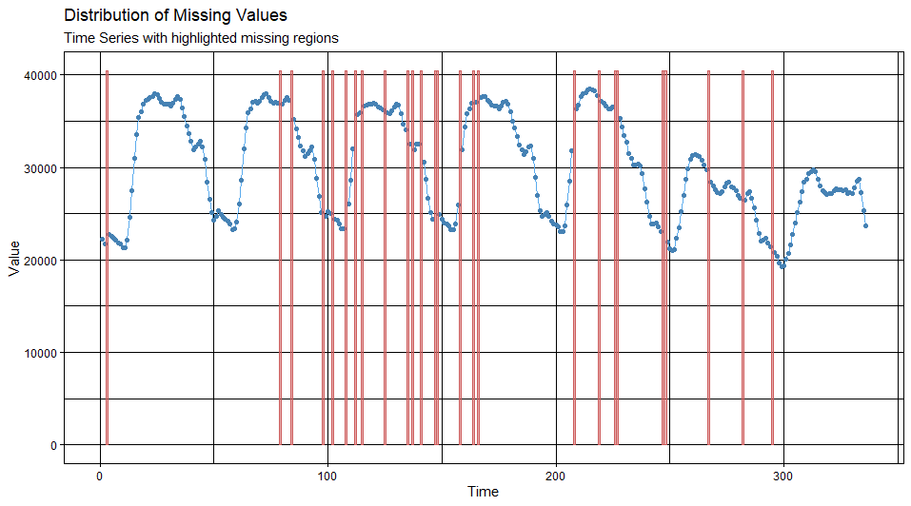
Missing Completely At Random (MCAR)
No systematic mechanism on missing data

Slide 6
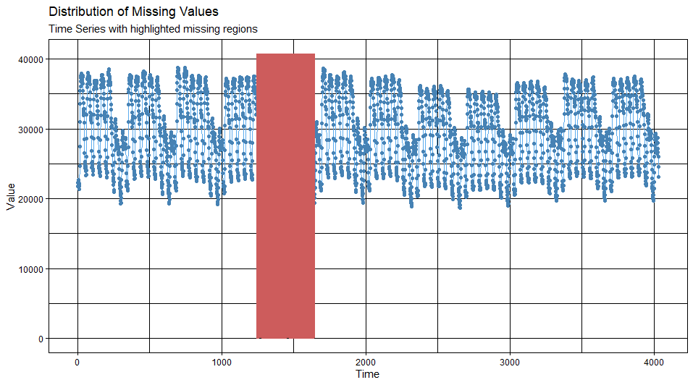
Missing At Random (MAR)
Data missing due to a reason (not completely random)

Slide 7
Taylor dataset: Half-hourly electricity demand
Half-hourly electricity demand in England and Wales in three months. Units: Megawatts
Discussed in Taylor (2003), and kindly provided by James W Taylor
Trend-Cycle | Seasonal | Remainder
Non-linear Trend | Complex Seasonality | Homoscedastic
12 Weekly Cycles 336 periods = 48 * 7 | Long: 48 periods (day) Long: 336 periods (week)

Slide 8
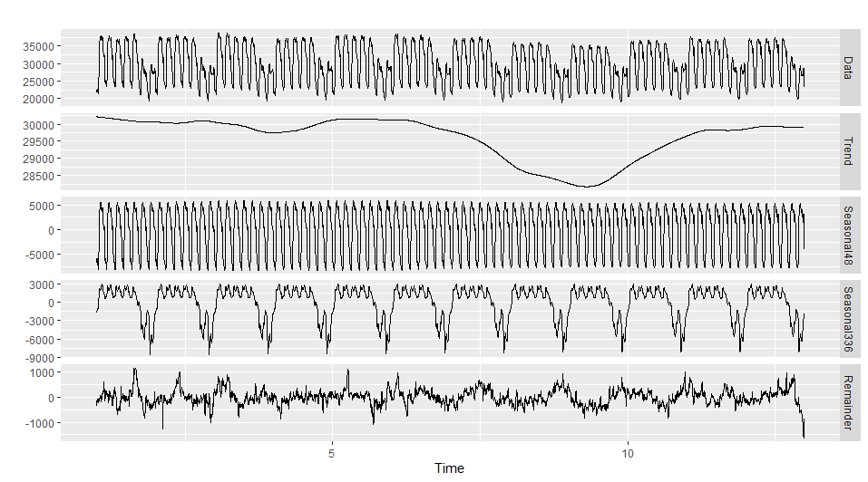
Taylor dataset components

Slide 9
Research question 1
The complex case is missing values occur in the time series with long seasonal periods and multiple seasonalities.
How can DHR be used for imputation in that case?

Slide 10
DHRFT adaptation for imputation
Step 1: Obtain imputed seasonal component using regression with Fourier terms
Y_{t} = Seasonal component + Dynamics
= (𝝱₀ + 𝝱₁X_{1,t} + … + 𝝱_{k}X_{k,t}) + 𝝶_{t}
→ Estimate coefficients to minimise 𝝶_{t}
X_{j,t} is a Fourier term
X_{1,t} = sin(2πt/m) , X_{2,t} = cos(2πt/m), X_{3,t} = sin(4πt/m) , X_{4,t} = cos(4πt/m), …

Slide 11
Residuals of the Regression 𝝶_{t}
Residuals of the regression (Dynamics, 𝝶_{t} = D_{t}) contains information of
Trend
Autocorrelations of nearby past values
Autocorrelations of seasonal past values
→ Decompose Dynamics, then fit the seasonally adjusted to an ARIMA model
→ interpolate the Trend using a Kalman filter

Slide 12
DHRFT adaptation for imputation
Step 2: Deseasonalize the Dynamics
Obtain seasonally adjusted series of Dynamics using STL decomposition* to fit an ARIMA model (M_{arima}).
After this step, we can also obtain Seasonal of Dynamics (S_{D}) as a result of STL
* STL: Seasonal and Trend decomposition using LOESS

Slide 13
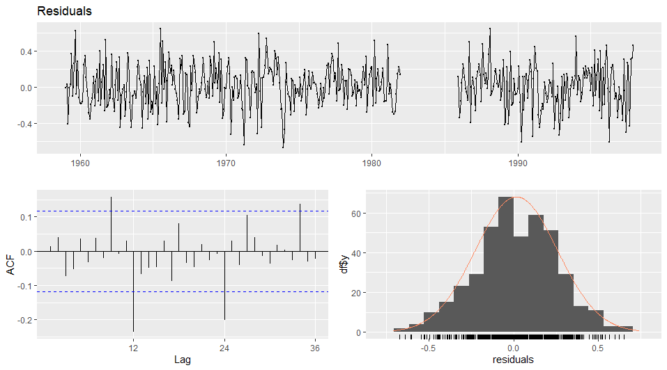
After step 2: Residuals of ARIMA, 𝝐_{t} (nearly white noise)

Slide 14
DHRFT adaptation for imputation
Step 3:
Obtain Trend component of Dynamics (T_{D}) using Kalman filter and smoother for ARIMA (M_{arima}) model in step 2.
Re-seasonalized the Dynamics by
adding back Seasonal component of Dynamics (S_{D}) (from step 2) to Trend component of Dynamics (T_{D}) to
get imputed Dynamics. (Imp_{D} = T_{D} + S_{D})

Slide 15
DHRFT adaptation for imputation
Step 4:
Add imputed Seasonal component (from step 1) to
imputed Dynamics component (from step 3)
to get the imputation for original series.
Imp = Imp_{s} + Imp_{D}

Slide 16
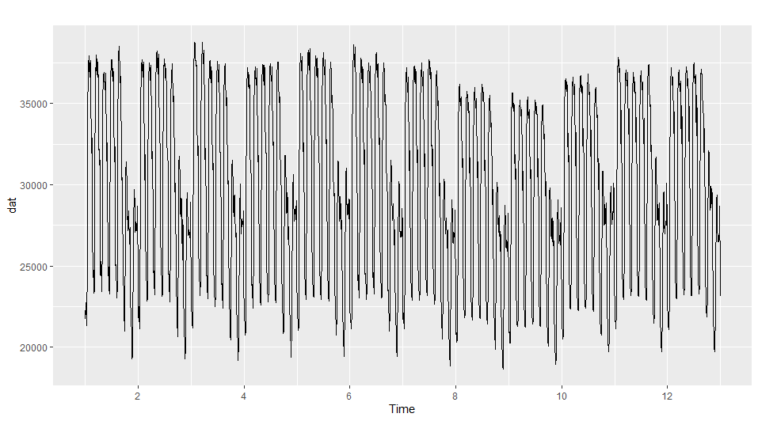
Apply to Taylor dataset

Slide 17
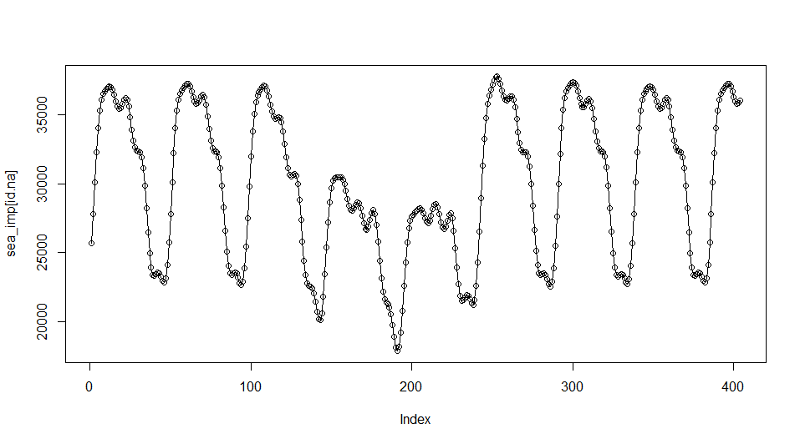
Step 1: Obtain imputed Seasonal component

Slide 18
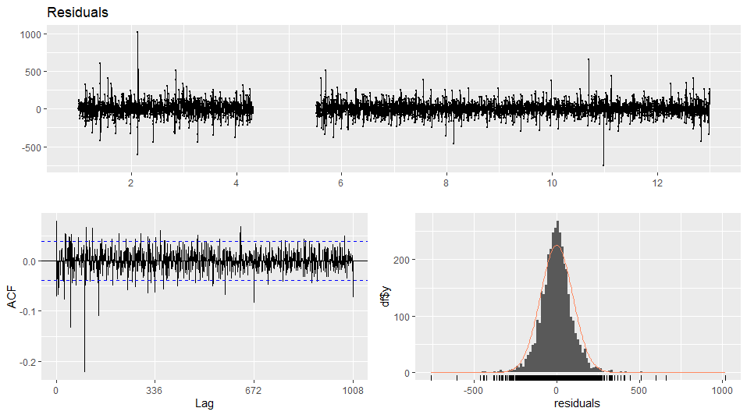
Step 2: Fit Seasonally adjusted of Dynamics to ARIMA
Residuals of
ARIMA, 𝝐_{t}
(nearly white
noise)

Slide 19
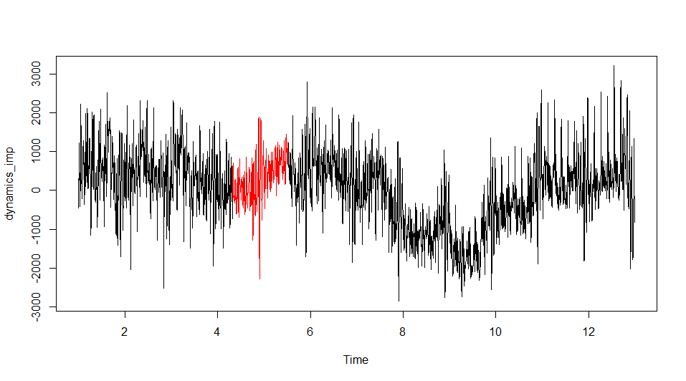
Step 3: Obtain imputed Dynamics component

Slide 20
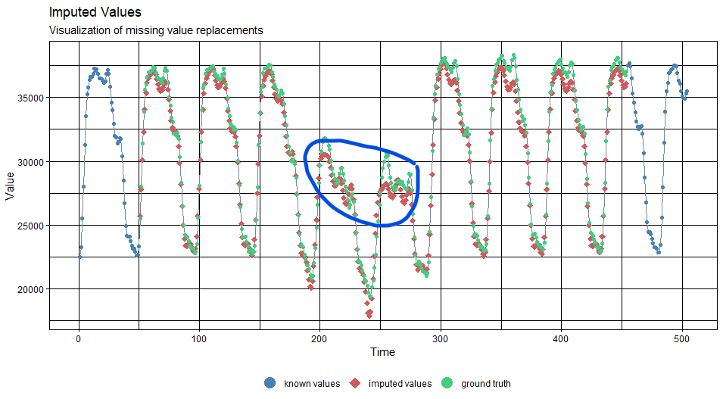
Add imputed Seasonal Component

Slide 21
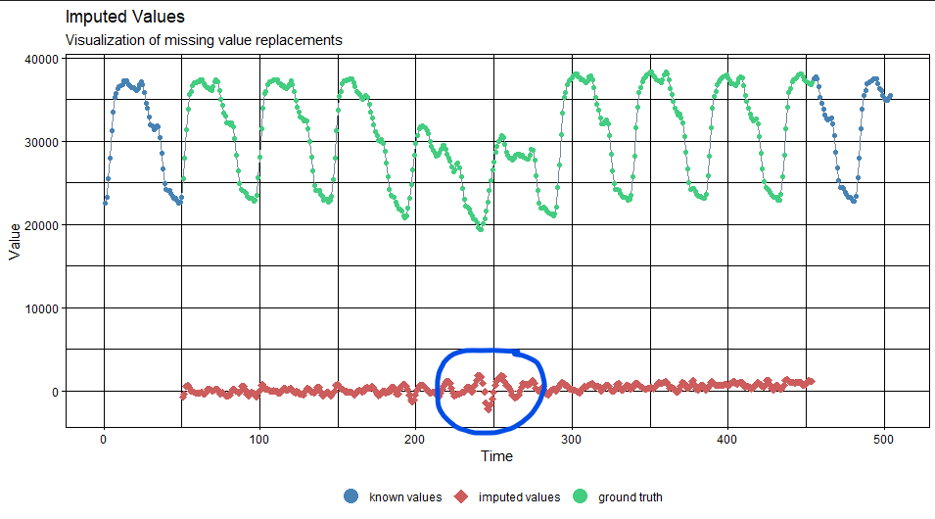
To imputed Dynamics Component

Slide 22
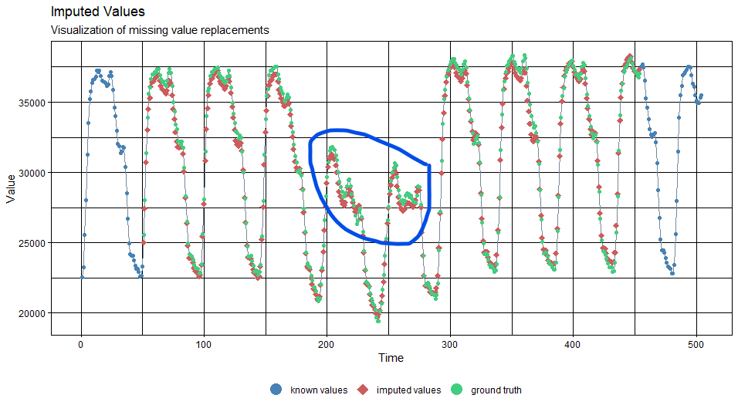
Step 4: To get the imputation of Original Series

Slide 23
Answer to question 1
To impute seasonalities, DHR employs Fourier terms of different frequencies.
In the suggested method uses STL to, once again, obtain seasonalities of dynamics, and the trend interpolation employs a Kalman filter and smoothing for an ARIMA model.

Slide 24
Research question 2
How well does DHR perform in cases where there are long seasonal periods and multiple seasonalities?

Slide 25
Evaluation
Metrics
MAE (Mean Absolute Error): MAE = mean(|e_{t}|)
RMSE (Root Mean Square Error): RMSE = sqrt(mean(e_{t}²))
MAPE (Mean Absolute Percentage Error)
MAPE = mean(|p_{t}|) where p_{t} = 100e_{t}/y_{t} is the percentage error
In which, e_{t} = y_{t} - y’ _{(t | t-1)} where y_{t} is observation at time t, y’ _{(t | t-1)} denotes
the forecast of y_{t} based on previous observations.

Slide 26
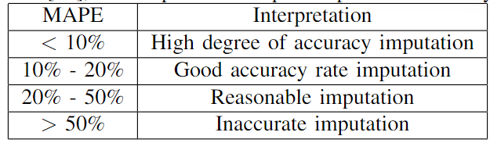
MAPE interpretations & Answer to question 2
high degree of accuracy imputation (missing rate <10%, MAR & MCAR),and
good accuracy rate imputation (10%< missing rate <30%, MCAR) for Taylor dataset.

Slide 27
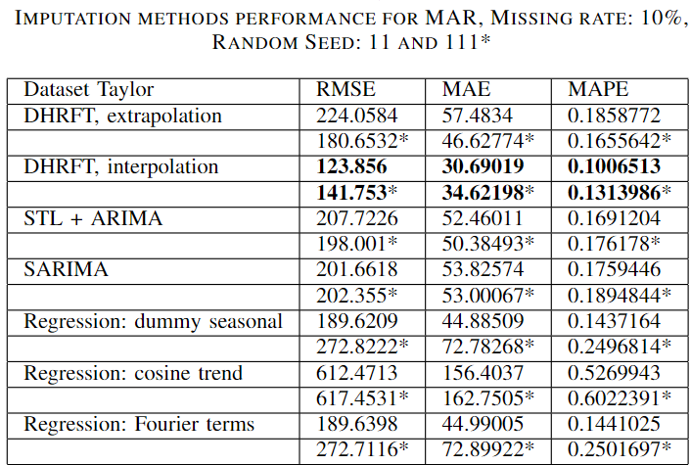
In MAR,
adaptation of DHRFT outperforms other methods at any rate.

Slide 28
Recommendations
It is recommended to effectively exploit the advantage of DHR by including external variables whenever possible, as domain knowledge plays a crucial role in determining the trend interpolation, and evaluating quality.
One should assume a local trend.
If there are (nearly) zero values in the series, MAPE can be arbitrarily large. MAPE interpretations do not hold. Set low imputed values to zero.

Slide 29
THANK YOU
I would like to thank my supervisors Dr. Joël M.H. Karel and Dr. Ralf Peeters for all their help and advice with this thesis.
I also appreciate all the support I received from the IconPro company in Aachen, Germany for the internship that allowed me to conduct this thesis.
THE END

Slide 32
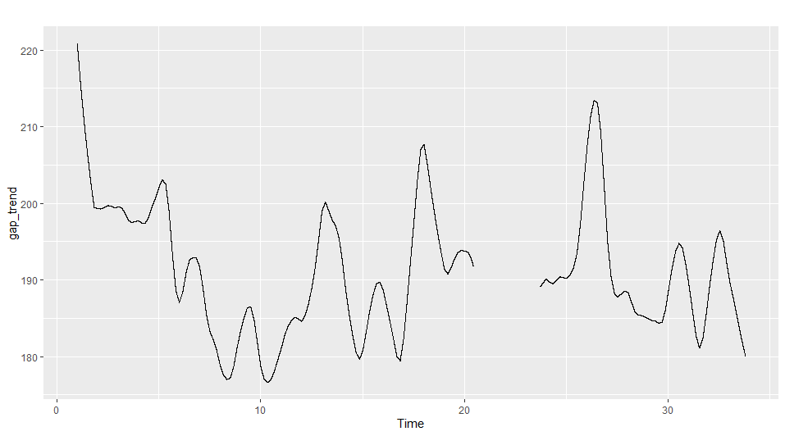
Handling trend is more challenging than seasonalities
Call dataset
Interpolation-able???

Slide 33
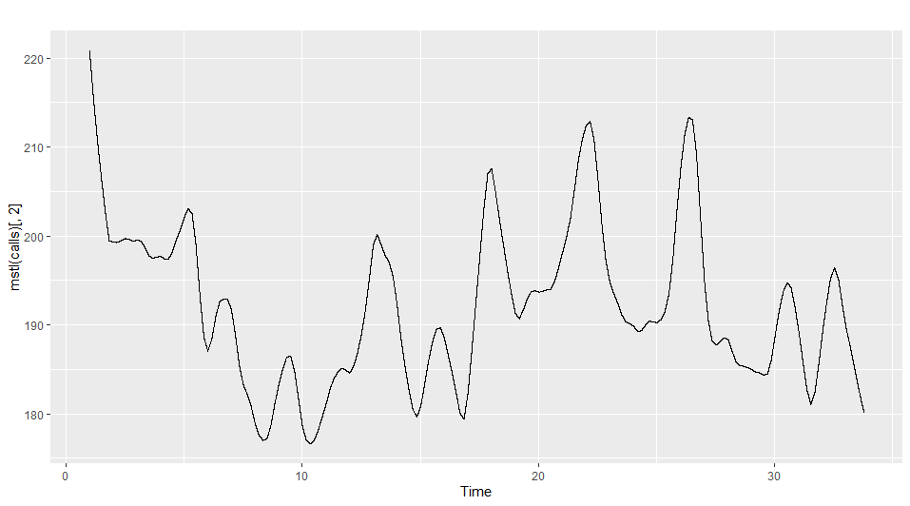
NO!

Slide 34
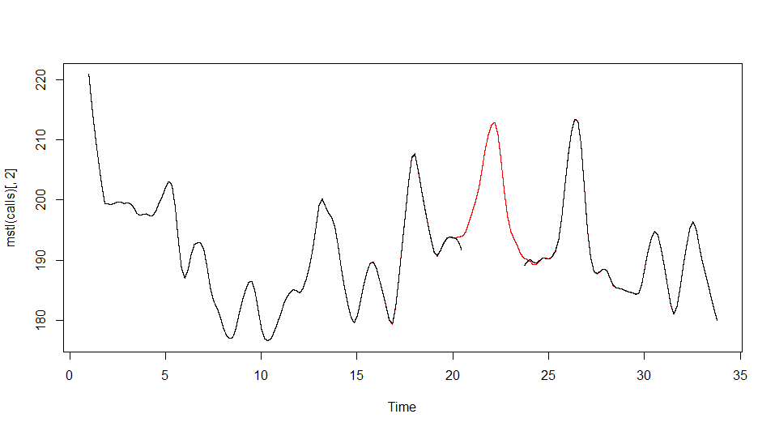
No external information → Trend can be any curve
Trend is known,
only in simulation
Compute errors can
be misleading, as in
reality, no true trend
(missing) to compare

Slide 35
Research question 3
How well does DHR perform in cases where the data is missing at MCAR and MAR?

Slide 36
Answer to question 3
In MCAR, DHRFT gives high degree of accuracy at missing rate less <= 10%, good accuracy at 10% < missing rate <= 30%,
reasonable imputation at 30% < missing rate < 50%.
When the rate > 50%, the imputation is inaccurate.
In MAR, the suggested adaptation of DHRFT gives high degree of accuracy at missing rate <= 10%, reasonable imputation at 10% < missing rate < 20%,
and inaccurate results for rate > 30%.

Slide 37
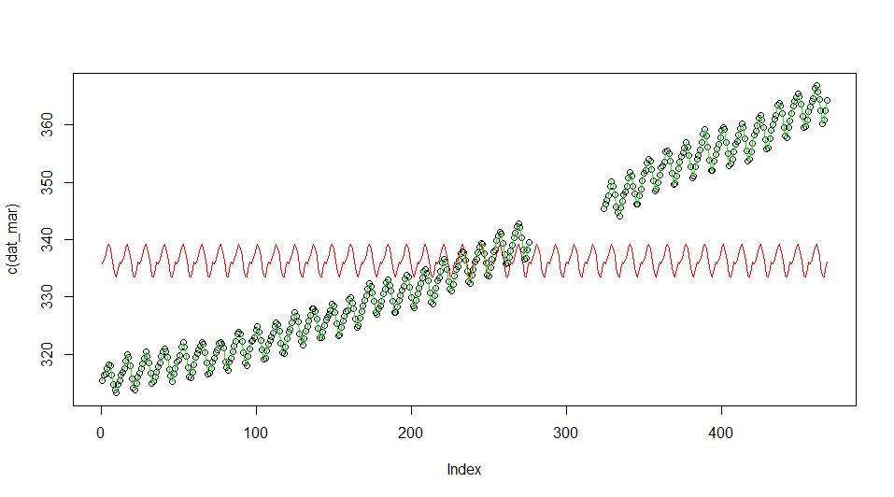
Add this red curve (imputed seasonal component)

Slide 38
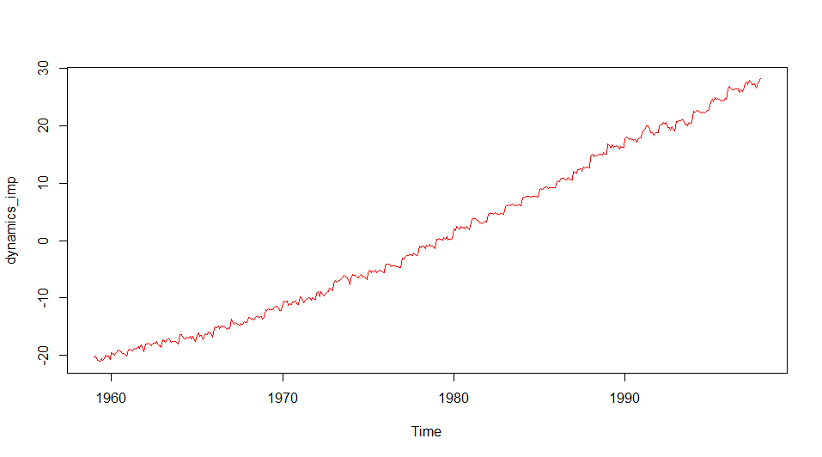
To this red curve (imputed dynamics component)

Slide 39
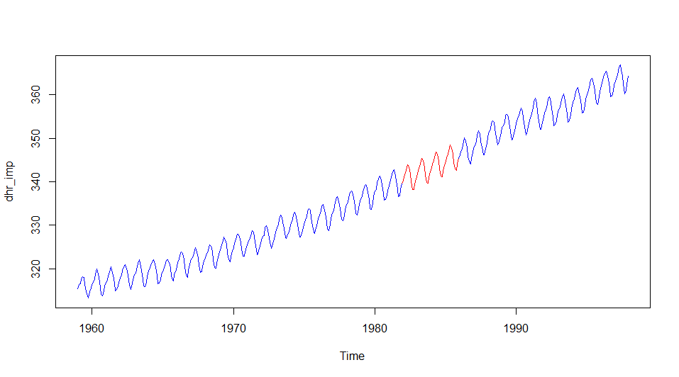
To get imputation for original series

Slide 40
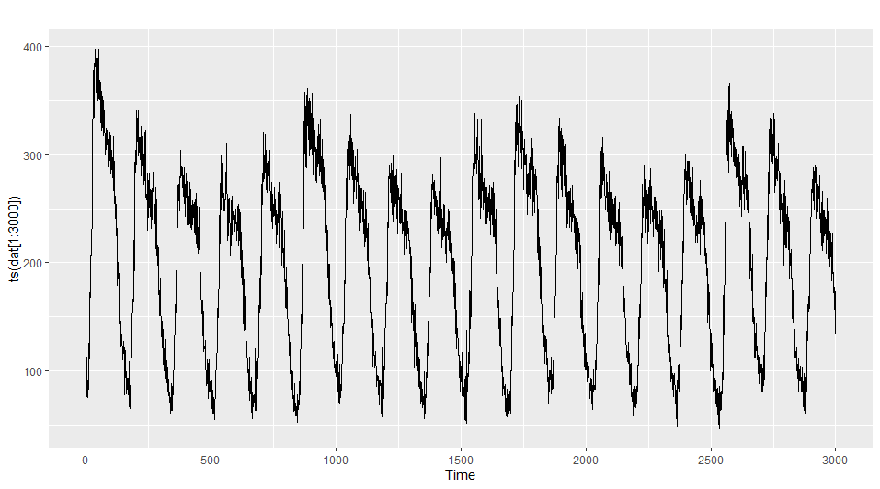
Calls dataset

Slide 41
Calls dataset
Call volume for a large North American bank
Trend-Cycle | Seasonal | Remainder
Non-linear Trend | Complex Seasonality | Heteroscedastic
 | Long: 169 periods Long: 845 periods

Slide 42
Experiments plan
Start with a complete time series ts_comp.
Remove data points according to missing mechanism (MCAR, MAR) to create an incomplete time series ts_miss.
Apply imputation methods to ts_miss to get ts_imp.
Compare ts_imp to ts_comp.

Slide 43
DHRFT adaptation for imputation
Step 1: Interpolate the seasonal component using regression with Fourier terms
Y_{t} = Seasonal component + Dynamics = (𝝱₀ + 𝝱₁X_{1,t} + … + 𝝱_{k}X_{k,t}) + 𝝶_{t}
Step 2: Obtain seasonally adjusted series of Dynamics using STL decomposition to fit an ARIMA model.
Step 3: Obtain Trend component of Dynamics using Kalman filter and smoother for ARIMA. Re-seasonalized by adding back Seasonal component of Dynamics from step 2 to get imputed Dynamics for original series.
Step 4: Add imputed Seasonal component to imputed Dynamics component
to get the imputation for original series.

Slide 44
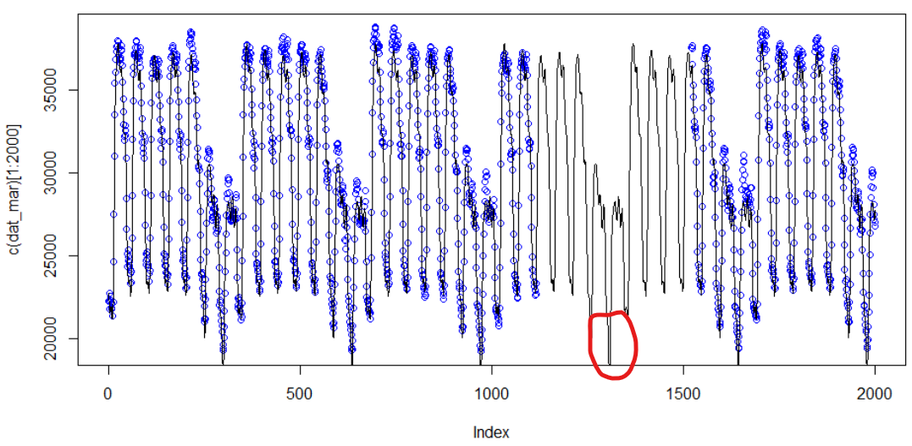

Slide 45
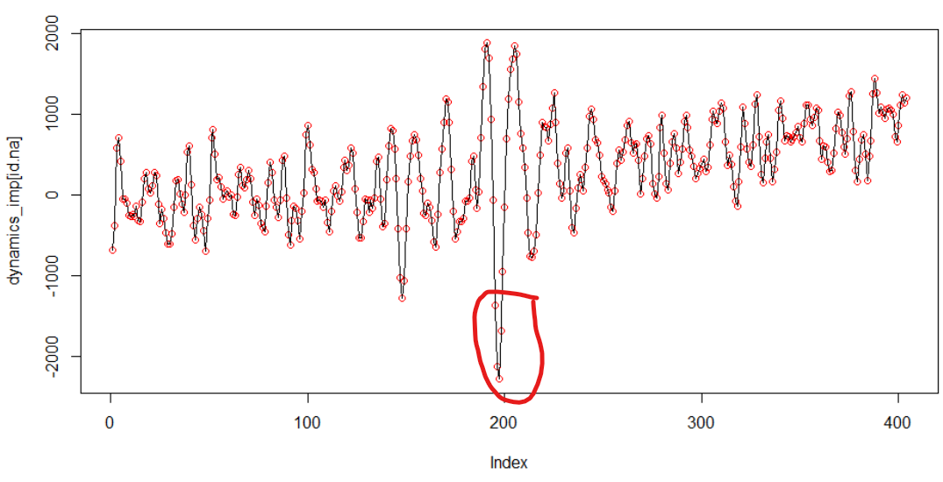

Slide 46
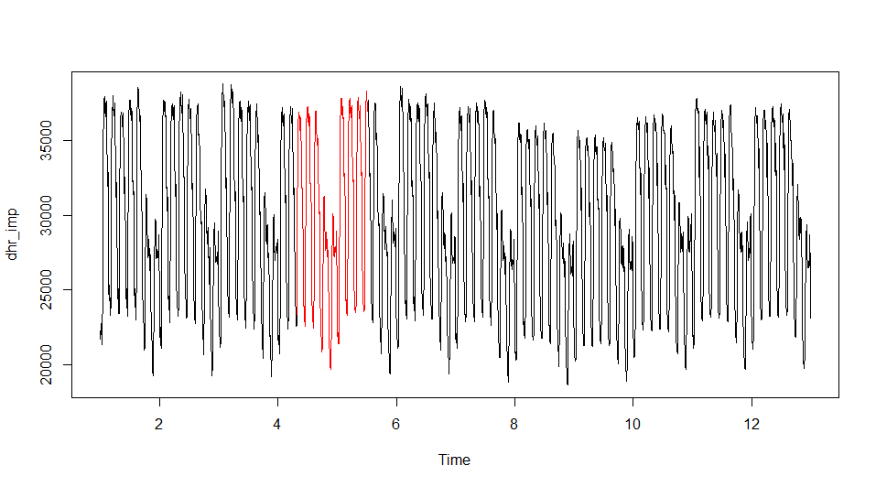
Step 4: Add imputed Seasonal to imputed Dynamics
To get
the final
Imputation

Slide 47
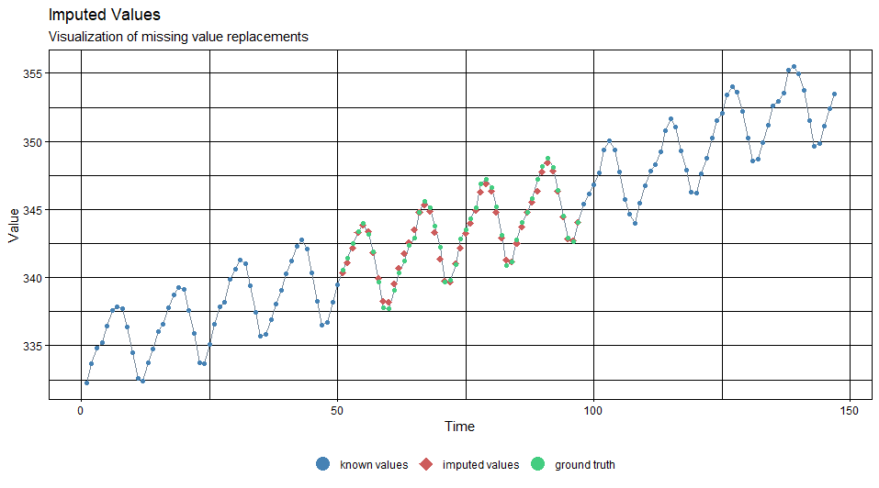
Get this: imputation for original time series

Slide 48
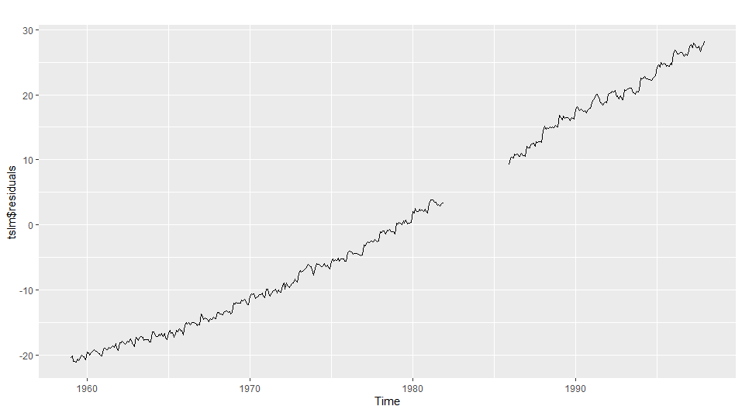
Residuals of the Regression 𝝶_{t} (Dynamics)

Slide 49
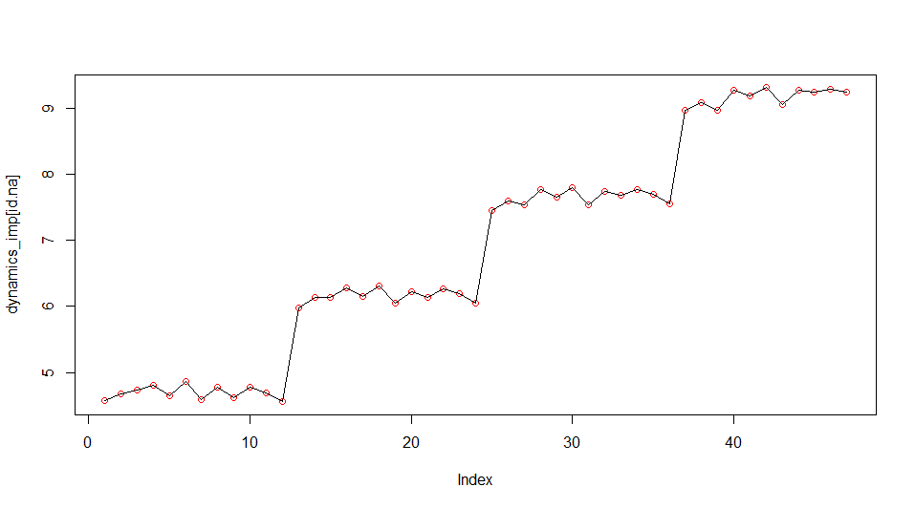
Step 3: dynamics component interpolation of CO₂ data

Slide 50
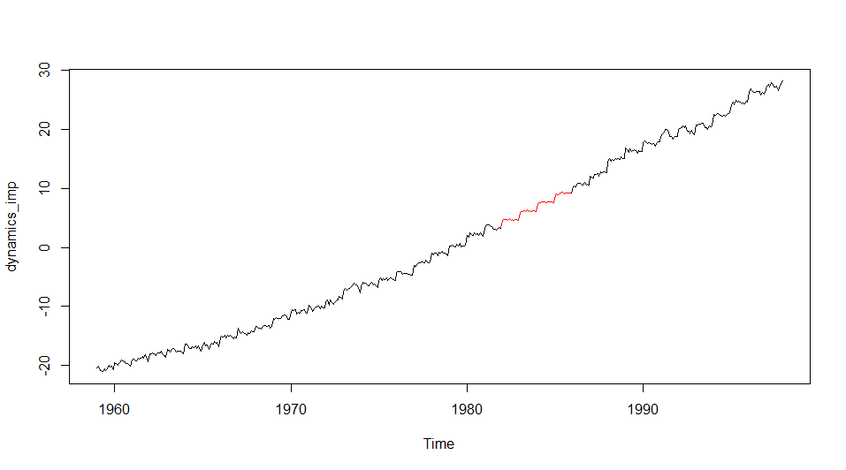
Step 3: dynamics component interpolation of CO₂ data

Slide 51
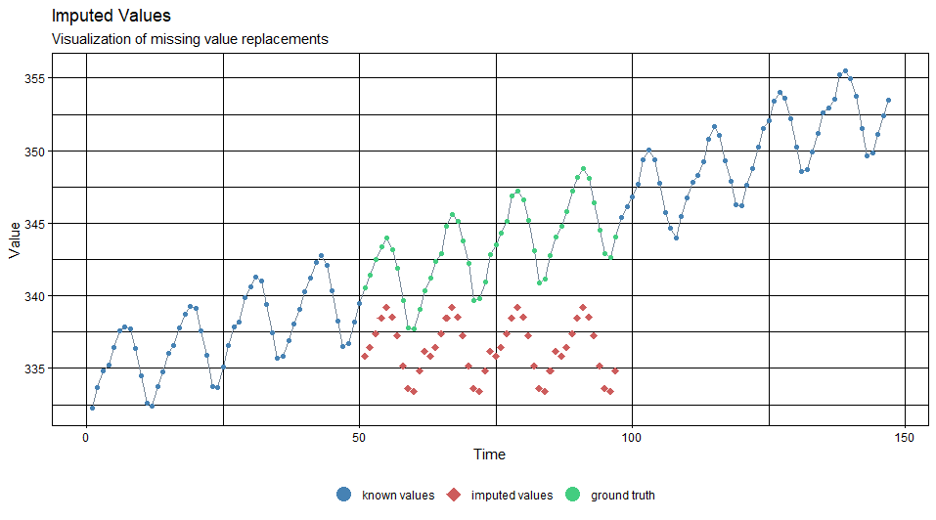
Step 1: seasonal component interpolation of CO₂ data

Slide 52
DHR with Fourier terms (DHRFT)
Y_{t} = S_{t} + D_{t} = S_{t} + (T_{t} + R_{t})
DHR uses Fourier terms to capture seasonalities, S_{t}
DHR let the Dynamics (T_{t} + R_{t}) for ARIMA to handle

Slide 53
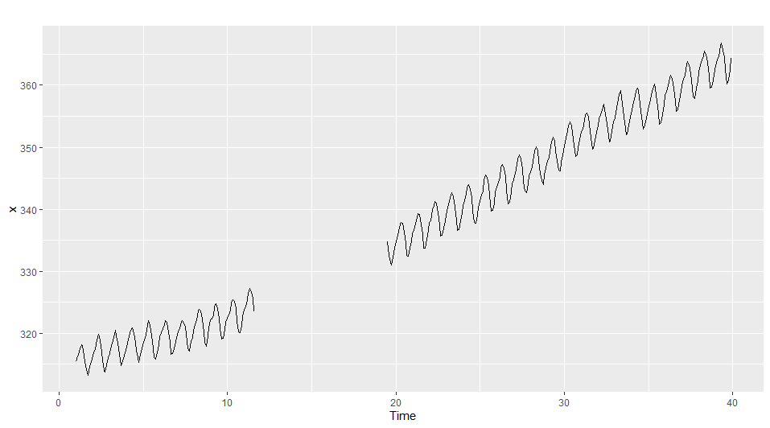
Example: CO₂ dataset with MAR gap

Slide 54
DHR with Fourier terms (DHRFT)
Assume Dynamics, 𝝶_{t} follows ARIMA(1, 1, 1), the formula for DHRFT
Y_{t} = 𝝱₀ + 𝝱₁X_{1,t} + … + 𝝱_{k}X_{k,t} + 𝝶_{t} Seasonal components, S_{t}
(1 - 𝝓.B)(1 - B)𝝶_{t} = (1 + 𝝧B)𝝐_{t} B - backshift notation
𝝶_{t} error from regression model (dynamics, D_{t} - not white noise),
𝝐_{t} error from ARIMA model (white noise)

Slide 55
Missing data simulation
MCAR: Generate values within interval [0, 1] from a continuous uniform distribution. Any values less than the missing rate are set to NA
MAR: Randomly select a time point in the series as the begin of the gap and make a gap with length corresponding to the missing rate.

Slide 56
Handling complex seasonalities approaches
Capture seasonality with Fourier terms of different frequencies (used in thesis)
Seasonal component is estimated iteratively using STL decomposition (used in thesis)
Including seasonal lags into SARIMA
DHR uses Fourier terms to capture seasonalities

Slide 57
Handling long seasonal periods (high-frequency series)
Using seasonal difference in SARIMA is undesired
That means to compare the current value to values that are far in the past (long seasonal)
High difference order introduces many NAs (equals the length of one seasonality, which is long) into series
Using dummy variables is undesired (number of dummies = length of one seasonality)
Both SARIMA and seasonal dummy model contains large number of parameters
→ Use Fourier terms to get a parsimonious model

Slide 58
STL (Seasonal and Trend decomposition using LOESS)
Suppose x_{i} and y_{i} for i = 1 to n, are measurements of independent and dependent variable
The Loess regression curve, g(x) is a smoothing of y given x that can be computed for any value x along the scale of the independent variable.
That is, Loess is defined everywhere and not just at the x_{i}
→ Important feature that in STL allow it to deal with missing values and detrend the seasonal component in a straightforward way.

Slide 59
Short answer to question 1
long seasonal periods and multiple seasonalities.
How can DHR be used for imputation in that case?
DHR uses Fourier terms to capture seasonalities to get a more parsimonious model than competitive models. Imputation steps are in next slides.

Slide 60
DHRFT adaptation for imputation
What if estimation for parameters to minimize 𝝶_{t} instead of 𝝐_{t}?
(ignore the correlations in the errors)
The estimated coefficients are no longer the best estimates, as some information has been ignored in the calculation
The AICc values of the fitted models are no longer a good guide as to which is the best model for forecasting.
In most cases, the p-values associated with the coefficients will be too small, and so some predictor variables will appear to be important when they are not. This is known as “spurious regression”.

Slide 61
Non-stationary Trend imputation for MAR data approaches
Trend is estimated iteratively using STL decomposition
Trend is handled by ARIMA model + Kalman filter (used in thesis)
Trend component is represented by polynomial of selected degree
DHR let the trend for ARIMA + Kalman filter to handle
The dynamics of DHR includes Trend-Cycle component, T_{t}
and Remainder component, R_{t}

Slide 62
DHRFT adaptation for imputation
What if estimation for parameters to minimize 𝝶_{t} instead of 𝝐_{t} again?
(ignore the correlations in the errors)
Problems above arises in the forecast context, we want to impute
To impute, a full forecast model is not needed, a component is enough
Multiple periodicities are captured in regression with Fourier terms
→ Seasonal component interpolation using regression with Fourier terms
→ Dynamics contain rich information, let treat it separately!

Slide 63
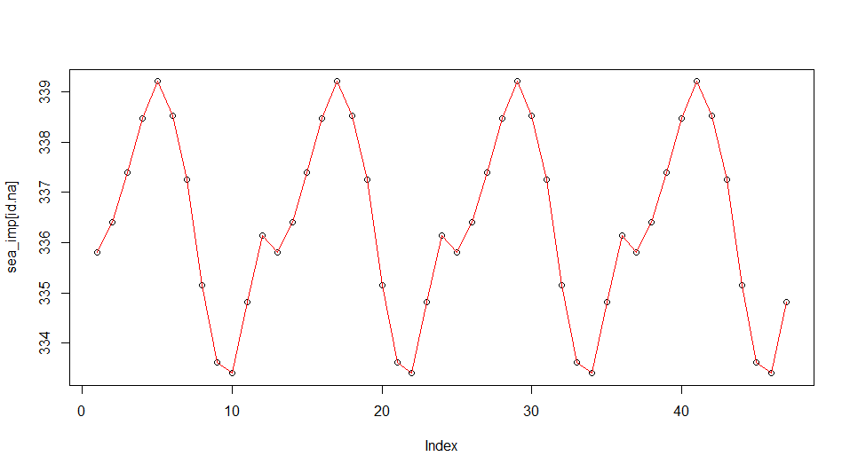
Step 1: seasonal component interpolation of CO₂ data

Slide 64
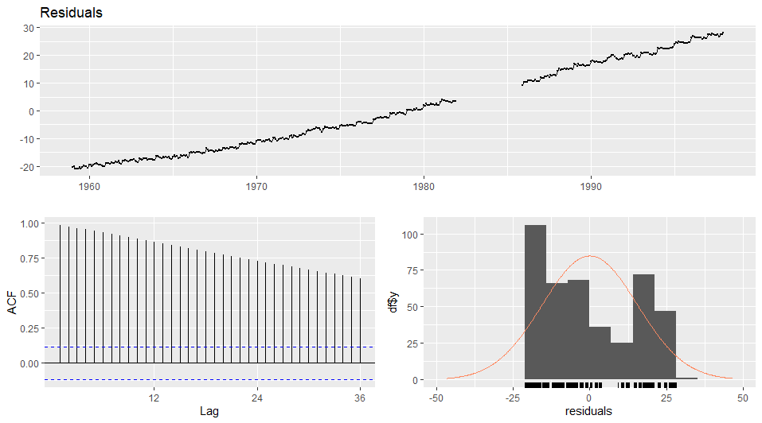
Residuals of the Regression 𝝶_{t} (Dynamics)

Slide 65
STL (Seasonal and Trend decomposition using LOESS)
STL stands for "Seasonal and Trend decomposition using Loess" and splits time series into trend, seasonal and remainder component
Loess interpolation (seasonal smoothing) is used to smooth the cyclic sub-series (after removing the current trend estimation) to determine the seasonal component.
Next another Loess interpolation (lowpass smoothing) is used to smooth out the estimated seasonal component.
In a final step the deseasonalized series is smoothed again (trend smoothing) to find an estimation of the trend component.

Slide 66
Kalman Filter and Smoother
Kalman Filter (forward algorithm) is a method of estimating the current state of a dynamic system, given the observations so far.
The smoother (backward algorithm) allows one to refine estimates of previous states, in the light of later observations (available in imputation context)

Slide 67
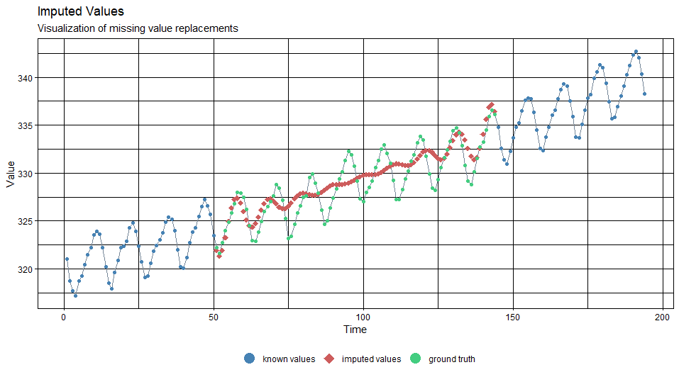
Kalman filter and smoother for CO₂ data (with seasonal)

Slide 68
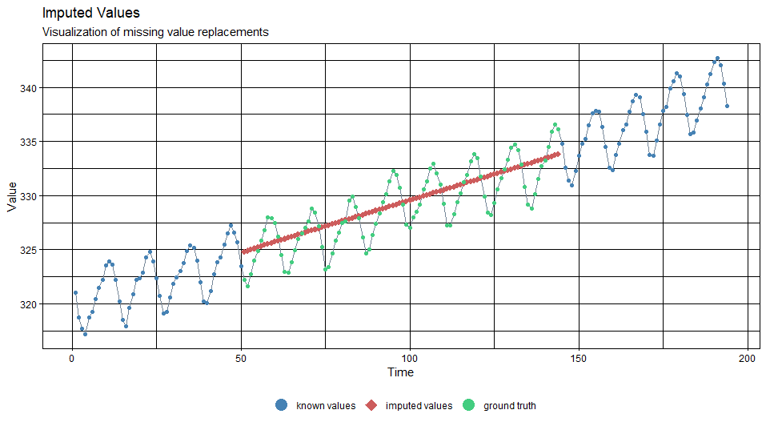
Trend of STL decomposition for CO₂

Slide 69
Add this: seasonal component interpolation of CO₂ data

Slide 70
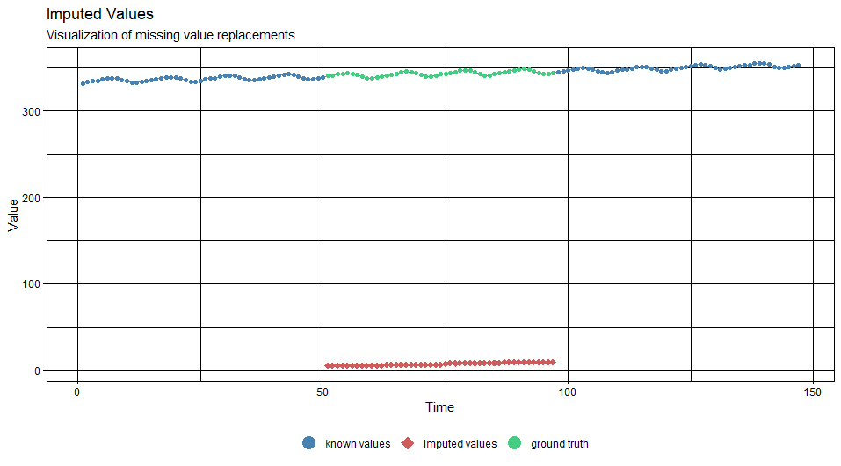
To this: dynamics component interpolation of CO₂ data

Slide 71
Step 3: dynamics component interpolation of CO₂ data

Slide 72
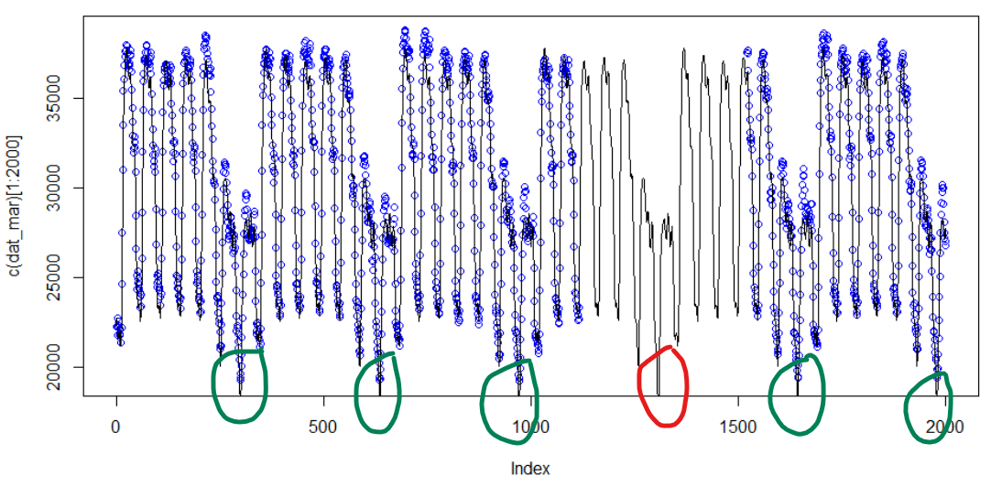

Slide 73
Error measurements can be misleading
Many consequences: MAR imputation quality is greatly dependent on the strategy of trend interpolation
Trend interpolation is purely the matter of luck
Best guess: Linear interpolation, Spline interpolation,…, No Best guess
The error measurements is unreliable, as the trend series is known in advanced, in practice, trend can be anything.
→ Need implicit assumptions to judge the quality
For example: No drastically variation in electricity load demand → Best guess: Linear interpolation, Mean, LOCF, …

Slide 74
More quality control for seasonal component
Many consequences for Trend imputation
Interpolation for Trend does not perform better than Extrapolation.
Sophisticated method to impute Trend does not perform better than Simple method.
→ Methods for trend imputation are incomparable.
→ Best strategy is to improve seasonalities imputation.

